Slide 1
Marching Greyhounds
Benefactor Program

Slide 2
Benefactor Levels
This fall the Marching Greyhounds are competing in the ISSMA and BOA competition circuits. About 15% of marching band and guard members rely on financial support from the Carmel High School Band Boosters to participate. We strive to give every student the opportunity to learn what it takes to achieve excellence. By becoming a Marching Greyhounds Benefactor, you help give students a unique opportunity to learn important life skills and grow personally and musically. In addition to your support, our students earn credit towards their participation fees through several fundraisers.
Competition Benefactor: $100-$249
This giving level can send one music or guard student to a marching band or winter guard competition.
Excellence Benefactor: $250-$499
This giving level provides funds for one replacement marching band uniform or one guard costume.
Silver C Benefactor: $500-$999
This giving level provide funds for major instrument repairs and purchases or for replacement flag poles, rifles and sabers.
Director’s Circle: $1000+
Members of the Director’s circle collectively provide financial support to marching band and fall/winter guard members who are unable to pay some or all activity fees which include original show music, drill and choreography, show props; music, visual and choreography staff and clinicians and many more items.

Slide 3
Benefactor Benefits
Level | Amount | Name listed on the Carmel Bands website. (1) | Name listed in the Fall Community Night program. | Special donor pin. | ¼ page student ‘serenade’ in the Fall Community Night program. (3) | Reserved seating for Fall Community Night Performance. (2) | Private group event with the directors. (4)
Competition | $100-$249 | X | X | X | X
Excellence | $250-$499 | X | X | X | X | 2 seats, top 50-yd line bleachers
Silver C | $500-$999 | X | X | X | X | 2 seats, press box
Director’s Circle | $1000+ | X | X | X | X | 4 seats, press box | 2 seats
The specified name and information will be listed on the Marching Arts Benefactor page on the Carmel Bands website for 1 year.
Press box seating is limited to 30 individuals. If capacity is reached, seating will be located on the highest bleachers at the 50-yard line.
The ‘serenade’ can include a student’s name, picture, year in school, and/or a short note. The ‘serenade’ can also be wishes for a section or the entire ensemble. Carmel HS Band Boosters reserve the right to shorten content and remove inappropriate material.
This fall event will include cocktails and a behind-the-scenes look at marching band. Topics include music and visual show design, insight into judging and more.

Slide 4
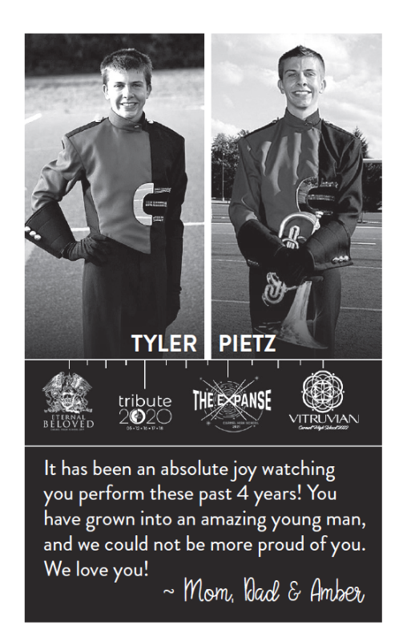
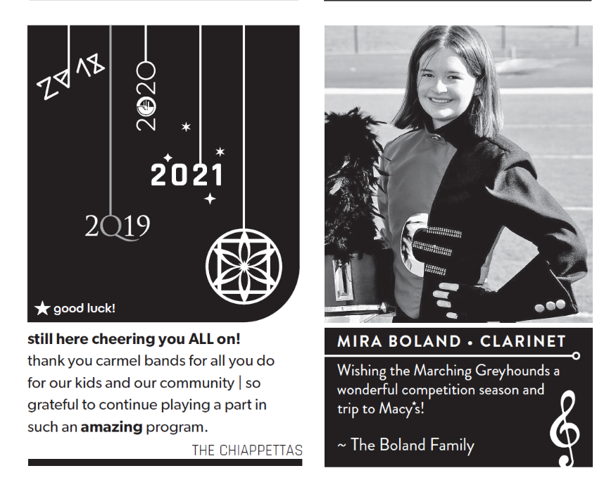
Serenade Examples

